Slide 1
Lecture 05 Analysis of algorithms
CSE225: Data Structures and Algorithms

Slide 2
Definition
An algorithm is a finite set of precise instructions for performing a computation or for solving a problem.
It must produce the correct result
It must finish in some finite time
You can represent an algorithm using
pseudocode,
flowchart, or
even actual code

Slide 3
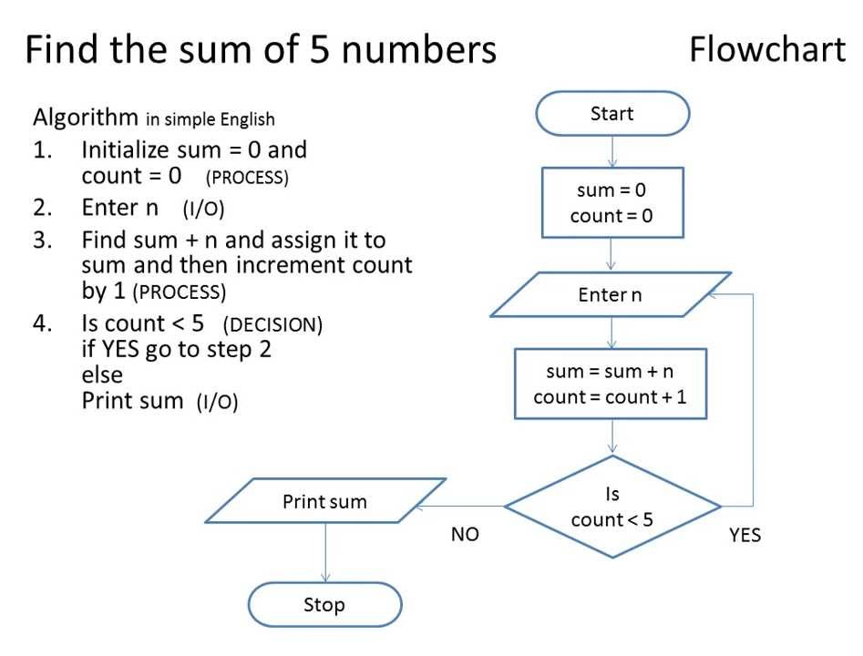
Algorithm Description : pseudocode vs flowchart
Next we will illustrate how the problem of sorting numbers can be solved using insertion-sort algorithm (represented using the pseudocode convention of Cormen et al.)

Slide 4
Analysis of Algorithms
What does it mean to analyze an algorithm?
To have an estimate about how much time an algorithm may take to finish, or in other words, to analyze its running time (aka. Time complexity)
Sometimes, instead of running time, we are interested in how much memory/space the algorithm may consume while it runs (space complexity)
It enables us to compare between two algorithms
What do we mean by running time analysis?
Also referred to as time-complexity analysis
To determine how running time increases as the size of the problem increases.

Slide 5
Analysis of Algorithms
Size of the problem can be a range of things, including
size of an array
polynomial degree of an equation
number of elements in a matrix
number of bits in the binary representation of the input
.
.
and so on…

Slide 6
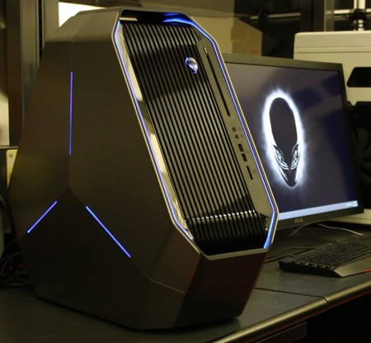
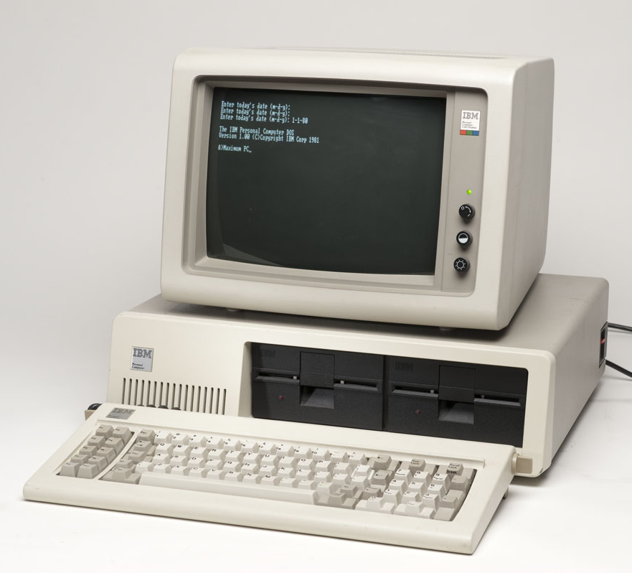
How Do We Analyze Running Time?
We need to define an objective measure.
(1) Compare execution times?
Not good: time is specific to a particular computer, operating system, etc !!

Slide 7
How Do We Analyze Running Time?
We need to define an objective measure.
(2) Count the number of statements executed?
Associate a "cost" with each statement.
Find the "total cost“ by finding the total number of times each statement is executed.
Not good: number of statements vary with the programming language as well as the style of the individual programmer.
Algorithm 1
Time (micro sec)
arr[0] = 0; c₁
arr[1] = 0; c₁
arr[2] = 0; c₁
...
arr[N-1] = 0; c₁
----------------------f(n)= c₁+c₁+...+c₁ = c₁N
Algorithm 2
Time (micro sec)
for(i=0; i<N; i++) c₁+c₂(N+1)+ c₃N
arr[i] = 0; c₁N
-----------------------------
g(n)= c₁+c₂(N+1)+c₃N+c₁N = (c₁+c₂+c₃)N+(c₁+c₂)
c₁
c₂
c₃
Observation: For very large values of N, execution time of both programs is similar. Thus we can say that both of them have roughly the same running time.

Slide 8
Ideal Solution to Express runtime in theory
Express runtime as a function of the input size n (i.e., f(n)) in order to understand how f(n) grows with n
and count only the most significant term of f(n) and ignore everything else (because those won’t affect running time much for very large values of n).
Thus the running times (called time complexity) of the programs of previous slide becomes:
f(N)= c₁N ≈ N*(some constant)
g(N) = (c1+c2+c3)N+(c1+c2) ≈ N*(some constant)
Thus both these functions grows linearly with N and as such both have the same running time (specifically, linear running time). We say that both of them are O(N) functions, which means that, the running time of each of these algorithms is a constant multiple of N (we ignore the value of the constant).
We compare running times of different functions in an asymptotic manner (i.e., we check if f(n) is > g(n) for very large values of n).

Slide 9
Advantage of Time Complexity
The notion of time complexity is independent of machine type, operating system, programming style, etc. As a result, we can easily compare the performance of two algorithms without thinking about the platform used to implement those algorithms.
Note:
Actual execution time is also important because sometimes we see that one algorithm has lower time complexity but in practice, it performs worse. This may happen, for e.g., in the following case:
Algorithm A has time complexity f(n)= cn and
Algorithm B has time complexity g(n) = dn²
So theoretically, algorithm A is better (takes less time) than B. But it turns out that B takes less time than A for real inputs. This may happen because
n is not large practice and
c >> d

Slide 10
Asymptotic Analysis (more examples)
Consider the example of buying elephants and goldfish:
Cost: cost_of_elephants + cost_of_goldfish
Cost ~ cost_of_elephants (approximation)
The low order terms, as well as constants in a function are relatively insignificant for large n
f(n) = 6n + 4 ≈ (some constant) n
g(n) = n⁴ + 100n² + 10n + 50 ≈ (some constant) n⁴
i.e., we say that n⁴ + 100n² + 10n + 50 and n⁴ have the same rate of growth. However, f(n) and g(n) have different rate of growths.
Which one grows faster for large values of n?

Slide 11
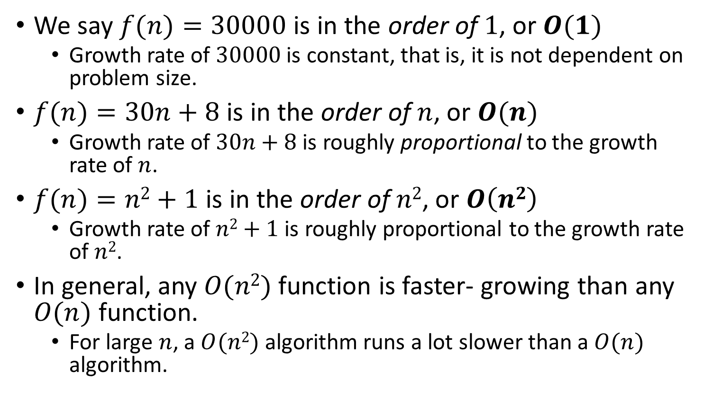
Big-O Notation
We say $f(n)=30000$ is in the order of $1$, or $O(1)$
Growth rate of $30000$ is constant, that is, it is not dependent on problem size.
$f(n)=30n+8$ is in the order of $n$, or $O(n)$
Growth rate of $30n+8$ is roughly proportional to the growth rate of $n$.
$f(n)=n2+1$ is in the order of $n2$, or $O\left(n2\right)$
Growth rate of $n2+1$ is roughly proportional to the growth rate of $n2$.
In general, any $O(n2)$ function is faster- growing than any $O(n)$ function.
For large $n$, a $O(n2)$ algorithm runs a lot slower than a $O(n)$ algorithm.
→ Constant time
→ Linear time
→ Quadratic time
O(2^{n}), O(4^{n}), etc. are called exponential time

Slide 12
Visualizing Orders of Growth
On a graph, as you go to the right, a faster growing function eventually becomes larger.
f_{A}(n)=30n+8
Running time→
f_{B}(n)=n²+1
Increasing n →

Slide 13
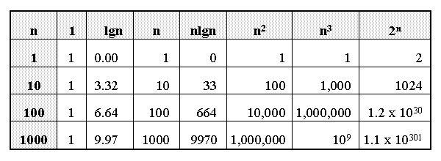
Growth of Functions

Slide 14
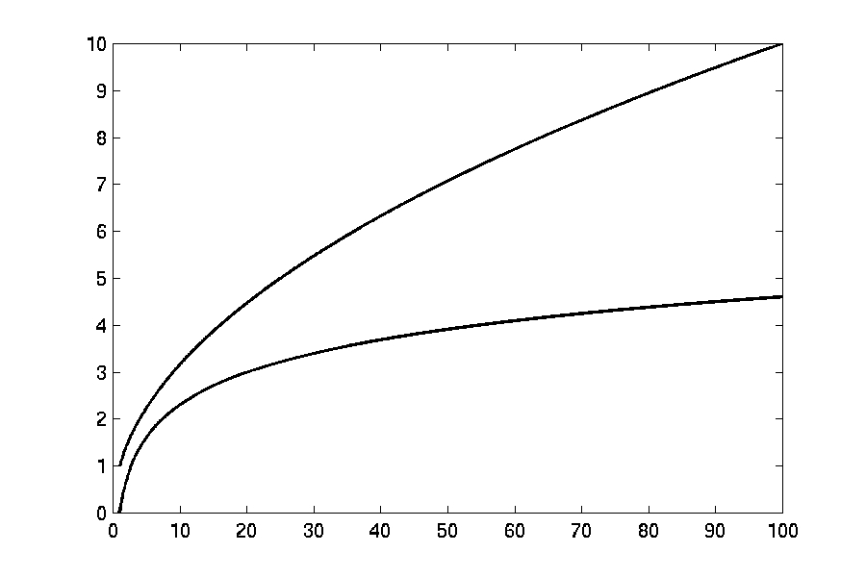
Complexity Graphs
log(n)

Slide 15
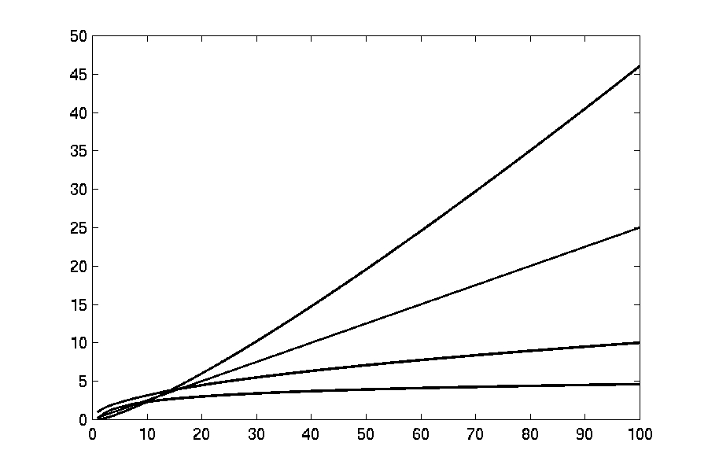
Complexity Graphs
n log(n)
n
log(n)

Slide 16
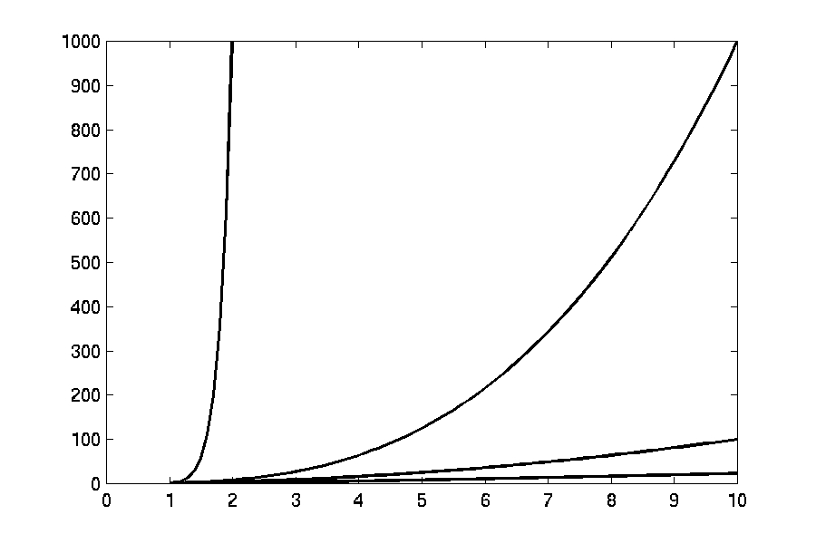
Complexity Graphs
n¹⁰
n³
n²
n log(n)

Slide 17
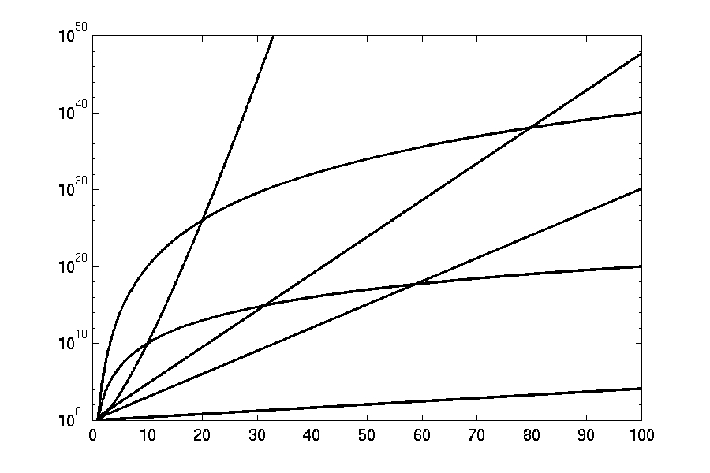
Complexity Graphs (log scale)
3^{n}
n^{n}
n²⁰
2^{n}
n¹⁰
1.1^{n}

Slide 18
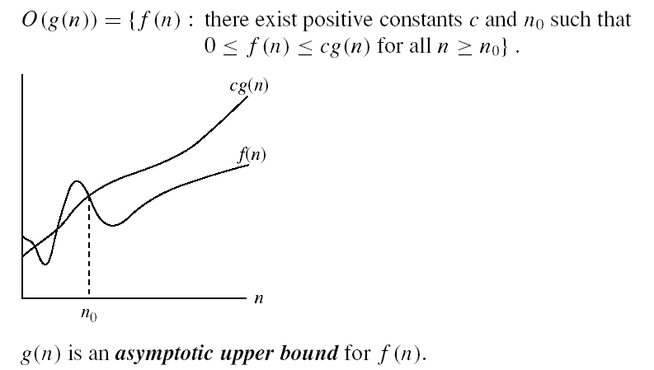
Asymptotic Notations
O-notation
O(g(n)) is the set of functions with smaller or same order of growth as g(n)
Examples:
T(n) = 3n²+10nlgn+8 is O(n²), O(n²lgn), O(n³), O(n⁴), …
T’(n) = 52n²+3n²lgn+8 is
O(n²lgn), O(n³), O(n⁴), …
Loose upper bounds

Slide 19
Proving Asymptotic Upper Bound
Show that T(n) = 3n²+10nlgn+8 is O(n²).
For n > 1 (because for n < 1, n² < 1) we have:
3n²+10nlgn+8 ≤ 3n²+10n²+8n²
3n²+10nlgn+8 ≤ 21n²
Therefore, for c = 21 and n₀ = 1:
T(n) ≤ cn² whenever n > n₀.
⇒ T(n) is O(n²).

Slide 20
Proving Asymptotic Upper Bound
Show that T(n) = 3n²+10nlgn+8 is O(n² lg n).
For n > 2 (because for n < 2, lg n < 1, so it is possible that n²lg n < n lg n which is true when n = 1.5) we have:
3n²+10nlgn+8 ≤ 3n²(lg n)+10n²(lg n)+8n²(lg n)
3n²+10nlgn+8 ≤ 21n²(lg n)
Therefore, for c = 21 and n₀ = 2:
T(n) ≤ cn²lgn whenever n > n₀.
⇒ T(n) is O(n²lgn).

Slide 21
Proving Asymptotic Upper Bound
Show that T’(n) = 52n²+3n²lgn+8 is O(n² lg n).
For n > 2 (because for n < 2, lg n < 1, so it is possible that n²lg n < n² which is true when n < 2) we have:
52n²+3n²lgn+8 ≤ 52n²(lg n)+3n²(lg n)+8n²(lg n)
52n²+3n²lgn+8 ≤ 63n²(lg n)
Therefore, for c = 63 and n₀ = 2:
T’(n) ≤ cn²lgn whenever n > n₀.
⇒ T(n) is O(n²lgn).

Slide 22
Proving Asymptotic Upper Bound
Show that f(n) = 5n²+3n²lgn-8 is O(n² lg n).
(do yourself)

Slide 23
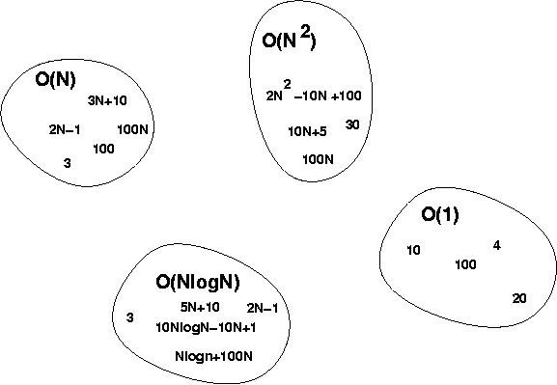
Big-O Visualization

Slide 24
Some Examples
Determine the time complexity for the following algorithm.
count = 0;
for(i=0; i<10000; i++)
count++;
We always want to know the tight upper bound; not some loose upper bounds

Slide 25
Some Examples
Determine the time complexity for the following algorithm.
count = 0;
for(i=0; i<10000; i++)
count++;
O(1)

Slide 26
Some Examples
Determine the time complexity for the following algorithm.
count = 0;
for(i=0; i<n; i++)
count++;

Slide 27
Some Examples
Determine the time complexity for the following algorithm.
count = 0;
for(i=0; i<n; i++)
count++;
O(n)

Slide 28
Some Examples
Determine the time complexity for the following algorithm.
sum = 0;
for(i=0; i<n; i++)
for(j=0; j<n; j++)
sum += arr[i][j];

Slide 29
Some Examples
Determine the time complexity for the following algorithm.
sum = 0;
for(i=0; i<n; i++)
for(j=0; j<n; j++)
sum += arr[i][j];
O(n²)

Slide 30
Does implementation matter?
Determine the time complexity for the following algorithm.
char someString[10];
gets(someString);
for(i=0; i<strlen(someString); i++)
someString[i] -= 32;

Slide 31
Does implementation matter?
Determine the time complexity for the following algorithm.
char someString[10];
gets(someString);
for(i=0; i<strlen(someString); i++)
someString[i] -= 32;
O(n²)

Slide 32
Does implementation matter?
char someString[10];
gets(someString);
for(i=0; i<strlen(someString); i++)
someString[i] -= 32;
Can we re-implement it to make it more efficient?
char someString[10];
gets(someString);
int t = strlen(someString);
for(i=0; i<t; i++)
someString[i] -= 32;
O(n²)
YES
O(n)
This example shows that a badly implemented algorithm may have greater time complexity than a more efficient implementation

